Slide 1
Introduction to Computers and Programming
Basic knowledge

Slide 2

Programming – Why?
Computers are used for many different purposes in many different situations.
The ability for a computer to be programmed allows it to do whatever their programs tell them what to do.
A program is a set of instructions that tell a computer what to do.
A computer cannot do anything unless it has a program to tell it what to do.
In this class, we will focus on writing these programs.

Slide 3
Programming – What?
Programs are used to operate the components of a computer, solve problems or satisfy a want/need.
  How long will it take me to get home if I drive x miles per hour?
  I want to be able to tell my friends what I am doing right now.
Computer Programming is both an Art and a Science
  Every aspect of a program must be carefully designed
As an art, programming takes creativity and problem solving.
  There is often no one correct way to solve a problem.
As a science, there are formal and proven methods to go about creating a programming.
In this course, you will learn both the art and science of programming.

Slide 4
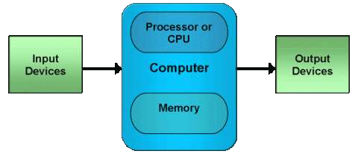
Hardware and Software
Programs can also be called software.
  Software refers to the computer programs that a computer uses to complete a task.
Hardware refers to the physical components that a computer is made of.
  A computer is not one device, but a system of devices working in tandem.
  Each device plays a part.
  Major components:
    Central Processing Unit
    Main Memory
    Secondary Storage Devices
    Input Devices
    Output Devices

Slide 5
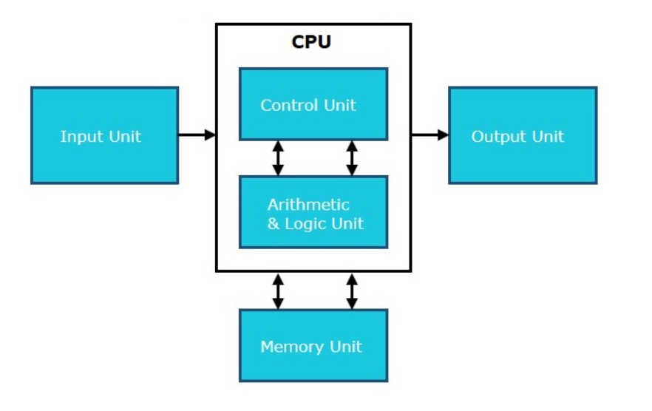
Central Processing Unit (CPU)
The CPU is the heart and brain of the computer.
The CPU continuously does the following things:
  Fetch an instruction
  Follow the instruction
  Produce some resulting data
The CPU has two parts:
  Control Unit
    Coordinates the computer’s operations
    Determines where to get the next instruction
    Regulates the other major components of the computer
  Arithmetic and Logic Unit (ALU)
    Designed to perform mathematical operations

Slide 6
Main Memory
Main memory holds information that the CPU needs to access quickly.
  Namely, the instructions to be executed.
When a program is running, some or all of its instructions are in main memory.
Memory is divided into sections called bytes that hold equal amount of data.
Each section is made up of 8 bits.
  A Bit is the most basic unit of information a computer can hold. It is a switch that is either on (1) or off (0)
Each byte is assigned and can be accessed by its address.
  A Memory Address is a unique identifying number associated with a byte in memory.
Main memory typically is volatile.
  Volatile Memory – is memory that when it loses power, the contents are erased.

Slide 7
Secondary Storage
Secondary Storage is memory that can hold data for a long period of time.
Programs are usually stored in secondary storage and loaded into main memory as needed.
  This forms a hierarchy typically called the memory hierarchy.
Common forms of secondary storage:
  Hard Drive
    Disk Drive
    Solid State Drive
  Removable Storage
    Floppy Disk
    CD-ROM
    USB Drives
Other files can be stored in secondary storage:
  Documents
  Pictures
  Whatever else you save on your computer

Slide 8
Input Devices
Input is any data the computer collects from the outside world.
An Input Device is anything that collects data and sends it to the computer.
Common Input Devices:
  Keyboard
  Mouse
  Scanner
  Digital Camera
  Disk Drive
  USB Drive

Slide 9
Output Devices
Output is any data the computer sends to the outside world.
An Output Device formats data and presents it to the outside world.
Common Output Devices:
  Monitor
  Printer
  Disk Drive
  USB Drive

Slide 10
Thank you

